Slide 1
Coforge AI GTM Enabling the AI-first vision

Slide 2
We are fusing our DNA of deep engineering and industry domain expertise with AI engineering skills to drive AI adoption at scale
WHAT WE HAVE BUILT OVER THE LAST 4+ YEARS
2750+ AI & Data Practitioners – Best-in-class AI talent to drive innovation
300+ Paid AI Deployments – Scalable, production-ready AI solutions delivered
50+ IP Innovations – Proprietary AI accelerators for rapid development & deployment
50+ Enterprise Clients – Trusted by industry across BFSI, Travel, Healthcare and more
20+ Partnerships – Collaborations with NVIDIA, AWS, Microsoft, Google and others
2000+ Certifications – Certified AI & ML experts ensuring enterprise-grade implementation
WHAT WE ARE DELIVERING
Enterprise Data & AI Technology Blueprints
Infrastructure for AI
Data for AI
Architecture for AI
AI Operations Managed Services
Outcome-led Industry Specific AI Solutions
Agentic AI Solutions
Data & Model Lifecycle Management
Responsible AI Guardrails
Governance

Slide 3

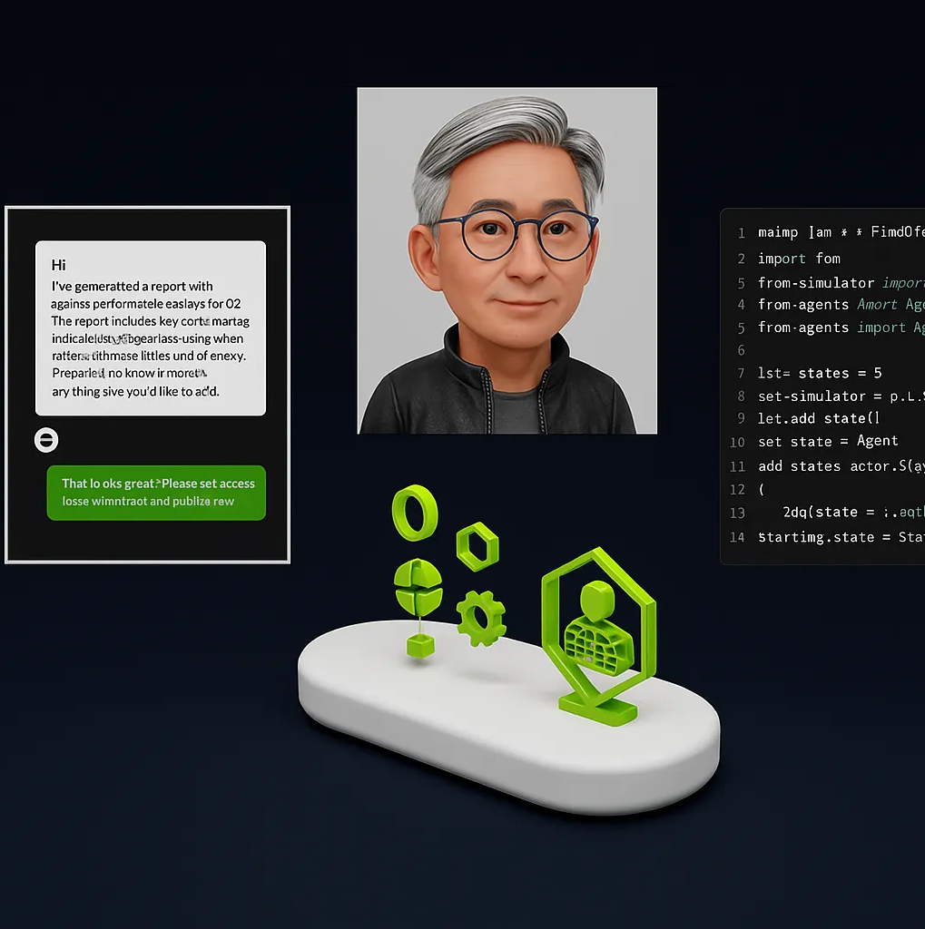




Coforge AI Spectrum: Perception. Generation. Autonomy. Execution
Physical AI
General Robotics
Edge Analytics
3D wayfinding
Video Analytics
Agentic AI
Coding Assistant
Customer Service
Responsible AI
Personal Information
Explainability
Perception AI/ Machine Learning
Generative AI
Digital Marketing
Content Creation
Speech/ Image Recognition
Neural Networks
Deep RECSYS
Self Healing Infra
Sales Agent
Recruitment Agent
PII
Bias Audit
Compliance
Contract Intelligence
Reverse & Forwarding Engineering Assist
Inspired by Jensen Huang’s AI Evolution
Fraud Detection
Risk Profiling
Context Aware Alerts

Slide 4
To continue driving our advantage, we are focusing our AI services strategy around 5 strategic pillars
OUTCOME LED AI STRATEGY
DATA & AI FOUNDATION
ACCELERATED AI INNOVATION
OPERATIONALIZATION & SCALABILITY
TALENT ENABLEMENT & CULTURAL CHANGE
AI initiatives aligned with business objectives
Phased AI implementation with ROI tracking
Scalable data & AI architecture & engineering platforms
Robust data & AI risk management & quality frameworks
Trust & reliability on AI solutions
Adherence to regulatory compliance
Industry-specific AI solutions
Pre-built accelerators to fast-track time-to-value
Scalable AI foundation to enable wider AI adoption
Continuous inference acceleration
Industrialized MLOps & LLMOps practices
Seamless integration of AI endpoints into business
Cost effective data & model management services
Scalable HW infrastructure
Enterprise-wide AI upskilling programs
Cultural alignment around data-driven decision-making
Stakeholder alignment from day 0
Notes:
Use Deepak

Slide 5
AI Driven Enterprise Transformation AI Driven Enterprise Transformation We’re bringing these eight AI capabilities to help drive faster, scalable adoption of AI across the enterprise
Adoption & Governance
(Talent Enablement, Industry Regulatory Guidelines & Compliance)
Outcome Led AI-Roadmap
(Strategy, Technology Blueprint & Action Plan)
Responsible AI
(Controls & Guardrails for Bias, Transparency, Privacy, & Ethical Concerns)
Inference Acceleration
(Strategy, Hardware, Architecture & Model Optimizations)
Industry & Function Focused
AI Solutions
(Integration Services & Assets)
Agentic Frameworks & Solutions
(ROI driven MVP for Scale)
Model Lifecycle As a Service
(Model Training, deployment, operations with automation)
Enterprise AI Foundation
(Infrastructure , Architecture , Data & Model )

Slide 6
Coforge Foundational AI Assets which will help enterprise adopt AI at Scale
We are strategically investing in robust foundational AI capabilities assets to serve as the bedrock for enterprise-wide transformation
Coforge Quasar Market Place
Curated Architecture Patterns designed to accelerate business transformation and unlock new possibilities
Coforge AI Studio
Comprehensive Tooling to Support AI Lifecycle Engineering
AgentSphere by Coforge
Curated agent marketplace with deployable agents
Coforge GenAI Central
For secure & optimized internal LLM usage
Coforge Quasar Gen AI Platform
Accelerate Gen AI solution deployment having 200+ pre-built Industry Solutions
Coforge Trust AI Solution
Secure bridge between users and AI models to confidently adopt and deploy AI solutions
LLMRouter by Coforge
Intelligent routing system that selects the optimal LLM for each query based on complexity. cost and performance.
Intelligent Document Processing
IDP for intelligent document classification and text extraction

Slide 7
Outcome-led AI Roadmap: Our approach to help establish a value-based AI roadmap
ASSETS
Business Alignment Framework
Use Case Prioritization Matrix
Value Realization Framework
ACTION PLAN
Pilot Execution​
Change Management​
Scaling Strategy​
Continuous Improvement
AI Governance Framework
AI Adoption Readiness Assessment
AI Operating Model
Roadmap Templates
Ready AI Solutions Across Archetypes
Pilot Execution Factory
BLUEPRINT
EXPERIENCE
Capability Mapping​
AI Operating Model​
Roadmap Design​
Budgeting
TECHNOLOGY
US Insurance Organization
(Assurant)
Discovery, Implementation with outcome defined for multiple process interventions in policy and claims across multiple GEOs
Achieved 95% automation of processes generating 80% efficiency, time reduction and high data accuracy
AI Architecture​
Tool and Platform Selection​
Data Readiness​
Model Development
US Investment Management Organization
(Voya)
Defines and establish AI led processes for legal & contract division.
Achieved 100% automated data processing for complex legal documents, reduced processing time from ~3.5 hours to ~2 min
STRATEGY
Vision & Objectives Alignment
Use Case Prioritization​
Value Realization Framework​
AI Strategy Design
AI Governance Framework
UK Semiconductor Organization
(ARM)
Defined and established AI CoE with outcome to be delivered around risk and governance
Standardized the architectural design best practices, tooling choices and technologies.

Slide 8
AI Foundation: Our areas of focus in setting up the AI foundation
AI Foundation
ASSETS
Pre-built Industry-Specific AI Solutions
AI Sandboxes and Innovation Lab
INFRASTRUCTURE
Storage Infrastructure
ARCHITECTURE
Cloud Data Platforms
MODEL
DATA
Enterprise AI Architecture
Feature Engineering
Model Observability & Monitoring
Real-Time Data
Data Quality and Lineage
Compute Infrastructure
AI Experimentation Environments
Containerization and Orchestration
Enterprise AI Tooling
AI Platform Build vs. Buy
Prompt Engineering & RAG Development
Automated Data Integration
AI Databases
(Vector DB, Graph DB)
Tokenization
Feature Store
Model Training & Testing Environment
MLOps & LLMOps
Model Registry
Ready-to-Deploy AI Accelerators
AI Toolkits and Frameworks
Vectorization Libraries
Containerized AI Environments
Cloud Infrastructure Blueprints
Ent. Architecture Blueprints
Data Infrastructure Blueprints
Model Infrastructure Blueprints
EXPERIENCE
Setup GenAI foundation using GCP as platform to enable multiple use cases. Involved creating setting up the complete Gen AI life cycle technologies.
Developed and deployed use cases for cut-down in IT tickets using the platform.
Travel Technology Major
Delivered an outcome-based AI roadmap around AI technologies specially around Microsoft AI and Copilots. Helped them establish AI based process definition for their vendors, employees, customers.
ASIAN Supply Chain Organization
(SIAM)
Responsible AI Foundation

Slide 9

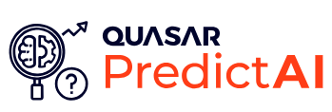




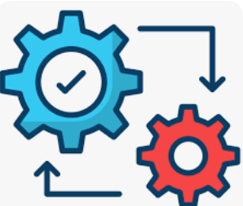

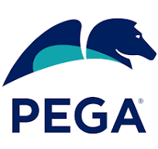
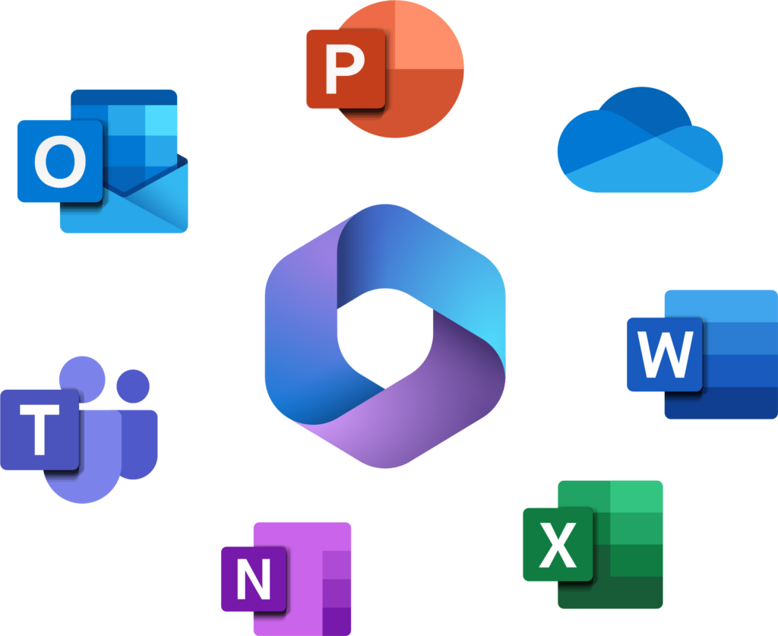
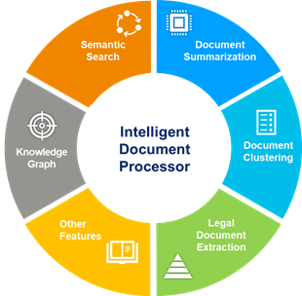
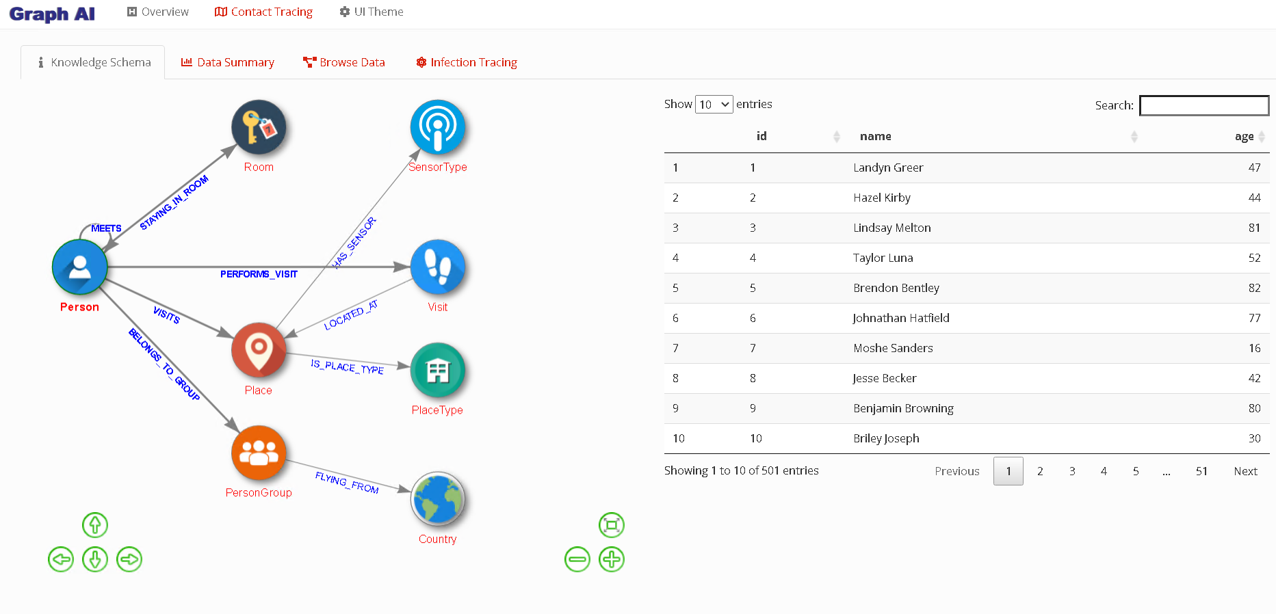
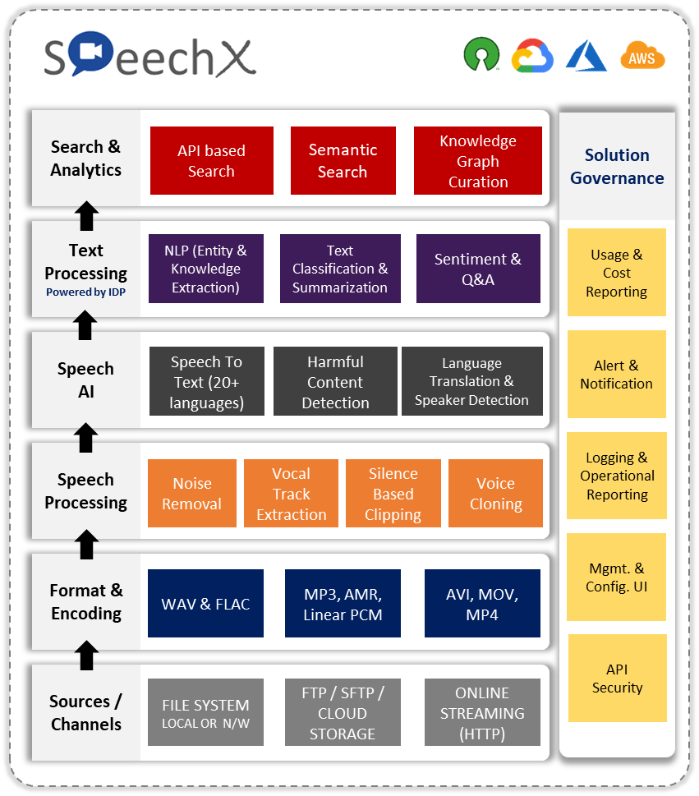
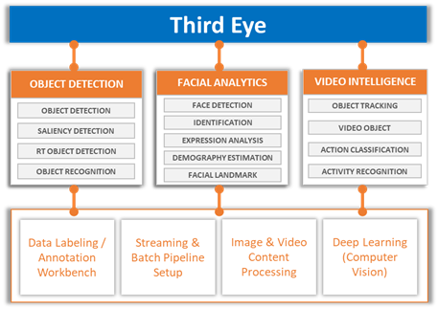
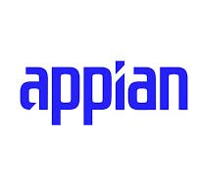
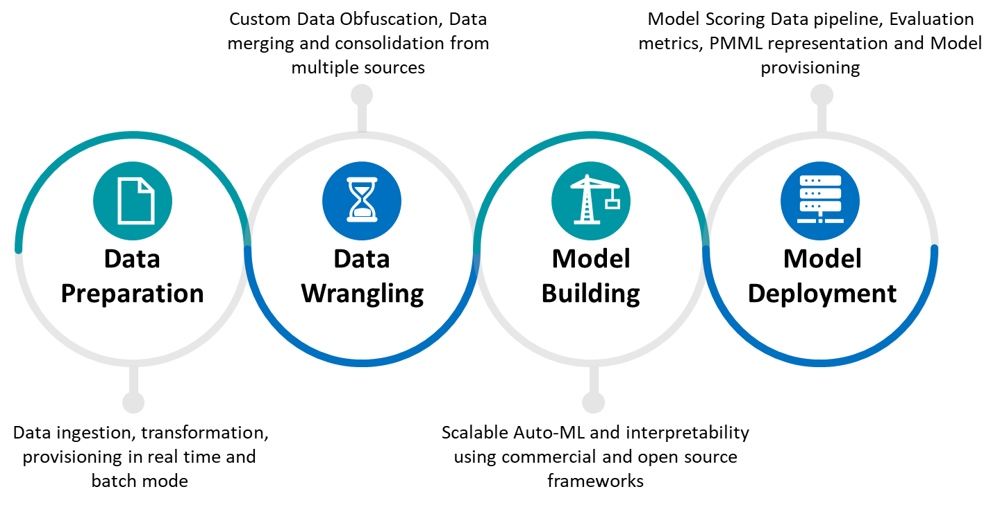


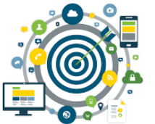

We have codified our experience into ‘Quasar’, a platform that houses AI Accelerators to help fast track AI adoption
Cognitive AI
Generative AI
Agentic AI
Responsible AI
Platforms & Tools
SaaS
Products
Extend
Copilot
Custom
Copilot
Intelligent Document Processor for Text Analytics
Accelerator for AI Models, MLOps LLMOps & Governance
LLM / ML /Deep Learning on Knowledge Graphs
Large Scale Speech Analytics (22+ languages)
Computer Vision AI for Images & Video Analytics
Copilot
(Code, Assistant and Others)
Native AI & Augment with external AI Capabilities

Slide 10
Industry Focused AI Solutions: Our assets and experience across multiple industries
ASSETS
EXPERIENCE
Document AI
MLOps and LLM Ops
Graph AI
Speech & Video AI
UK Insurance Organization
(SOMPO)
Submission management for underwriting efficiency – Unique solution for Submission Management using AI for underwriters.
Built complete process starting from data ingestion, data enrichment, ML/NLP models, negotiations, risk modelling and feeding to PAS systems
Achieved 96% automation with 80% efficiency (time reduction) and 100% accuracy for decision making
Peer Analysis or Competitor Analysis Platform
Matching & Mapping Competitors Products
Augmented Sales Engine
Customer Segmentation and Loyalty Program & Loyalty Fraud
Loss Run Data Processing and Reporting
Submission Management Solution for Underwriters
Property Inspection Using Smart Glass
Fraudulent Claims
Global Airline
(Cathay)
Automation of reading and processing AWB for airline cargo using handheld devices.
Improved data accuracy and reduced the time of availability of data to backend processing engine to <1 min from >3mins
Investment Research for Portfolio Analysis
Predictive Collection for better planning
Predictive Models for reducing False Positive in AML
Automated Accident Claims using Voice Chatbots
Built a Loss Run Files processing SaaS solution to consume multi format loss run files, enrich data from multiple sources, create & consume in data lake and provides highly configurable reports and dashboards.
Reduced overall timeline for accumulation and processing of data by ~80% along with easily configurable reports and dashboards improves customer experience
US Underwriting Analytics
(Aurenity)
Fictitious Booking
Cargo Delay Prediction
Airplane Turnaround Optimization
Real Time Ancillary Recommendation
US Large Bank
AI Solution to perform check fraud detection across multiple critical parameters in the check image
Different kinds of verification including logo, signature, positioning of standard statements in check, check borders detection
Automation of Electronic Bill of Lading / Invoice Processing
Customer conversation Analytics for better CX
Financial Narrative Summary
Agent Assist for Contact Center Employees

Slide 11
Agentic Frameworks & Solutions: Our approach to enable agentic AI on the bedrock of predictive & generative AI foundation
ASSETS
Responsible Agentic AI Framework
Agentic Mesh Architecture
Agentic AI Business Controls
Multi-Agent Sales Agent Framework
Optimus –Sales Agent for Airlines
Agentic Employee Assist
DESIGNING AGENTIC AI ARCHITECTURE
MEASURING ROI OF MVPS
EXPERIENCE
BUILDING MVPS
Define & Measure against Key Metrics​
Define Business Value Realization
Built a research workflow using AI agents for a medical research topic.
Delivered efficiency with minimal human interventions, higher coverage and optimal accuracy.
Helped cut down the GTM cycle by 25%
Foundation Models & Capabilities​
Agentic AI Framework​
Responsible Agentic AI
Build Architecture Components
Identifying High-Impact Use Cases​
Apply MVP Design Principles​
Execute Agile Development
UK Publishing Organization
(BMJ)
SCALING THE MVP
Scaling Framework​
Governance & Compliance​
Continuous Optimization
Automated recruitment process with AI agents for mapping, matching and scoring JDs vis-à-vis candidates
Helped in improving closure of processes by reducing cycle time by ~30% without dropping on overall volume
US Investment Management Organization
(SEI)
US Manufacturing Organization
(Beacon)
Developed knowledge management AI Agents with RAG for products search on website to improve customer experience.
Handled large products catalog (33K products across categories) with 100% accuracy

Slide 12
Model Lifecycle as a Service (MLaaS): Our AI model management services handles lifecycle of AI/ML models helping scale efficiently and at lower cost of operations
ASSETS
Data Acquisition from Multiple Sources
Data Cleaning and Transformation
Feature Engineering
Vectorization
Domain-Specific Models
Pre-trained LLM-Based Solutions
(1)
Data Engineering & Preparation
(3)
Model Validation and Testing
(4)
Model Deployment and Operation
(5)
Model Monitoring and Maintenance
(6)
Model Governance and Compliance
(2)
Model Development and Training
Version Control
Access Management
Regulatory Compliance
Ethical AI Practices
Reusable Feature Stores
Model Libraries for Common ML Tasks
Algorithm & Best-fit Models Selection
Model Training with Distributed Training
Hyperparameter Tuning
Model Explainability
Model Template
Synthetic Data Generators
CI/CD Pipeline for ML
ML Sandbox Environments
Model Strategy and Design
Containerized Model Serving
Drift Detection Modules
Model Lifecycle as a Service (MLaaS)
Model Registry and Marketplace
Automated Model Retraining Pipelines
Use Case Identification
Value and ROI Definition
Solution Architecture
Technology Stack, Framework & Infrastructure Selection
Cross-Validation through Robust Training-validation Splits
Bias and Fairness Testing
Tracking Performance & Accuracy Metrics
Stress Testing
EXPERIENCE
Airline Software Provider
(FlyDubai)
Created MLOPS as a Service platform for consuming and engineering AI and ML models. Reduced the overall model cycle time by ~25% along with deployment automation.
Performance Tracking
Drift Detection
Retraining Pipelines
Cost Optimization
EU Asset Mgmt. Org.
(NNIP)
Created MLOps using AWS from data consumption, data wrangling, data processing, NLP models for context search engine on ~35 years of research data set
Achieved a response time of < 1s for any query along with ~99% correct match in the 1st attempt
Model Packaging & Containerization
Cloud-Native Deployment & Hosting
MLOps Pipelines with Versioning, Deployment, and Rollback
US Financial Services
(SBI)
Created ML pipelines for reducing false positive alerts in AML transaction analysis.
Achieved overall identification and reduction of 72% false positive alerts

Slide 13



Inference Acceleration: Optimizing and speeding up the execution of AI models to scale AI solutions
Multi-GPU & Multi-Node Inference
Edge-Cloud Hybrid Inference
Serverless Inference
Hardware Selection for Acceleration
Hardware Implementation
Define Inference Strategies
Hardware Selection
Design Serving Architecture
Execute Model Optimization
Serving Frameworks and Server Selection
Processing Selection (Batch vs. Streaming)
Model Quantization
Model Pruning
Knowledge Distillation
Model Compilation & Graph Optimization

Slide 14
Responsible AI (RAI): Our framework establishes AI guardrails that evolves with industry-specific regulatory requirements, ensuring ethical, secure, and compliant Data & AI solutions
IMPLEMENT STANDARD & ADVANCED GUARDRAILS
Standard Guardrails: Ethical Guardrails, Technical Guardrails, Security Guardrails, Compliance Measures​
Advanced AI guardrails: AI Agents, Generative AI Guardrails, Real-Time Monitoring Tools, Customizable Frameworks​
Build custom-made​
Calibrate and integrate 3rd party solutions
DEFINE STANDARD AI CONTROLS
Identify business impact, ethical standards, and regulatory requirements​
Define ethical AI principles by ensuring fairness, accountability, and transparency​
Define bias mitigation, enhance model explainability with clear audit trails​
Establish data privacy through encryption, anonymization, and access controls​
Responsible AI Solution Framework
DESIGN TECHNOLOGY FRAMEWORK
Design architecture and technology components - Anomaly detection across guardrails, encryption and access control, real-time monitoring & feedback loop, and human oversight mechanisms
Design automated validation, testing mechanisms
Design a modular architecture that can adapt to new AI use cases and technologies​​
DEFINE ADVANCED AI CONTROLS
ESTABLISH MATURITY ROADMAP
In alignment with industry-specific controls with frameworks like GDPR, HIPAA, and BFSI​
Establish AI risks points from model drift, security vulnerabilities​
Define monitoring and maintain human oversight for critical decision-making​
Baseline compliance, data security, and model quality checks​
Scale governance frameworks and automate validation ​
Advance to continuous compliance with evolving regulations
Apply automated governance and proactive risk management.​
Notes:
Integrating various tools and techniques to ensure AI systems operate within ethical, legal, and technical boundaries
Data Quality Security & Privacy
Model Explainability
Bias Detection & Mitigation
Ethical AI Controls Frameworks
API Gateways
Monitoring & Observability

Slide 15
RAI Solutions: Our robust suite of responsible AI assets and accelerators to help organizations build, deploy, and scale AI solutions ethically, transparently, and with proper governance
ASSETS
EXPERIENCE
RAI Governance Framework
AI Risk Management Toolkit
Southeast Asian Food Operator
The Coforge developed IT assist solution now leverages the Trust AI framework, ensuring responsible and secure AI interactions by mitigating hallucinations and prompt injection, and prioritizing data privacy.
Ethical AI Design Framework
Bias Detection & Mitigation Rules Framework
Indian PSU Bank
Coforge's integrated solution, combining its Trust AI Framework and Knowledge Center Solution, provides capabilities for PII leakage detection, LLM response accuracy checks, and ongoing performance evaluation of the Azure OpenAI GPT-4o model.
Fairness Scorecards
Explainability Dashboards
Model Drift Detection Accelerators
AI Performance Monitoring Framework
Data Anonymization & Masking Pipelines
RAI Training Modules
RAI Playbooks
AI Ethics Workshops
Notes:
Integrating various tools and techniques to ensure AI systems operate within ethical, legal, and technical boundaries
Data Quality Security & Privacy
Model Explainability
Bias Detection & Mitigation
Ethical AI Controls Frameworks
API Gateways
Monitoring & Observability

Slide 16
AI Adoption & Governance: We offer a range of professional services designed to address functional, technical & cultural transformation underpinned by governance
Skills and Cultural Transformation Services
Framework that educate, train and equip technical, non-technical and sr. leaders on AI fundamental, business impact and data-driven decision making
AI Compliance and Governance Regulations Services
Framework and approach that comprehensively addresses ethical, legal, and operational standards
AI Center of Excellence Setup
[CoE Operationalization – Innovation Lab]
Stakeholder Alignment & Collaboration
[Cross-functional Workshops – KPI-led Value Realization - Communication]
Cultural Transformation & Change
[Data-Driven Culture Programs - AI Adoption Playbooks - AI Champions Network]
Compliance Training & Awareness
[Compliance and Ethics Training]
Enterprise-wide AI Upskilling
[AI Literacy Workshops - Role-based AI Training - Executive AI Bootcamps]
Update on Evolving Regulations
Ensure AI-based decisions are transparent, explainable to regulators
Continuous Monitoring and Auditing
Conduct automated monitoring and auditing along with regular manual reviews
Establish AI Governance & Compliance Frameworks
Support in defining policies and procedures in compliance with regulations like GDPR, EU AI, HIPAA
Provide oversight on AI initiatives
Documentation and Transparency
Continuous update, employee training on regulatory changes
Support with research & POVs to help participate in industry events and forums
Risk Assessment & Predictive Compliance
Conduct assessments to identify compliance risks
Use historical data to forecast compliance trends & risks
Provide documentation support

Slide 17
How Can We Help to Realize AI Vision

Slide 18
Our goal is value creation leveraging AI technologies across key measurable dimensions
Revenue Uplift
Cash Flows
Cost Reduction
Increasing income via AI innovations
Enhancing liquidity with AI solutions
Minimizing expenses through AI efficiency

Slide 19
We’ve used a three-pronged approach to deliver our AI capabilities with focus and impact
Placeholder
01
We help customers identify, define, and prioritize high-impact AI opportunities, while assessing their current AI maturity and outlining the capabilities needed to achieve their target state.
Insert your desired text here.
Value-Led AI Opportunity & Capability Assessment
Placeholder
We showcase transformative AI use cases - drawn from real-world implementations across industries - to inspire new ways of thinking and uncover innovative opportunities to reimagine business processes and functions.
Insert your desired text here.
Three-pronged Approach to Enable AI Capabilities
Inspiration Through the Art of the Possible
We collaborate with customers to design and implement AI solutions that address specific business challenges or opportunities, delivering tangible outcomes and measurable value.
Solving Targeted Business Needs with AI
Placeholder
04

Slide 20
We apply a Value vs. Cost framework to identify and prioritize high-ROI use cases in industry verticals (Ex: Retail)
Defend through protecting core value enabling operational stability & compliance and cost reductions
Extend through optimizing existing processes enabling efficiencies and value expansion
Upend by innovating and creating net-new value to leap ahead
Value and Competitive Impact
High
AI-powered virtual shopping assistants / stylists
Hyper-personalized marketing engines
Voice and visual search with AI
AI-generated product design (based on trend or customer data)
Personalized Product Recommendations
Demand Forecasting with ML
Dynamic Pricing Optimization
Personalized Sales & Marketing
Financial Forecasting & Closing
AI-driven Fraud Detection
Customer Service Automation
AI for Regulatory Compliance
Intelligent Automation of Operational Tasks
Coding Assistants
40 - 300% ROI
20 - 60% ROI
10 - 20% ROI
Low
Low
* AI Total Cost, Complexity and Risk
High
* Value and Cost Framework by Gartner
Notes:
Defend: This involves leveraging AI to protect and optimize existing business models and revenue streams. The focus is on enhancing efficiency, improving customer retention, and mitigating risks. AI applications in this category typically offer incremental improvements.
Extend: This focuses on using AI to enhance existing products, services, and processes to create new value for customers and gain a competitive edge. AI solutions here often lead to improved customer experience, new feature offerings, and process differentiation.
Upend: This involves employing AI to create entirely new business models, products, or services that disrupt existing markets or create new ones. These are often high-risk, high-reward initiatives with the potential for significant impact.

Slide 21
Value – Time - Effort Prioritization Matrix
QUADRANT | LABEL | DESCRIPTION
Q1 (Top Left) | Quick Wins | High value, short timeline, low effort – prioritize for rapid realization and fast ROI
Q2 (Top Right) | Scalable Growth | High value, longer timeline – invest and scale with a mid-to-long-term roadmap
Q3 (Bottom Right) | Automate or Delegate | Low value, longer timeline – deprioritize or automate with minimal investment
Q4 (Bottom Left) | Low-Yield Experiments | Low value, short timeline – use as learning pilots or proofs of concept; deprioritize for scaled investment unless strategic alignment exists.
Effort Size
Q1
Q2
Value
This matrix plots AI use cases based on:
X-axis (Time): Estimated time to realize value
Y-axis (Value): Business value potential (e.g., savings, revenue uplift, experience enhancement)
Bubble size (Effort): Estimated implementation complexity, resource demand, and technical effort required
Q4
Q3
Time

Slide 22
Case Examples

Slide 23
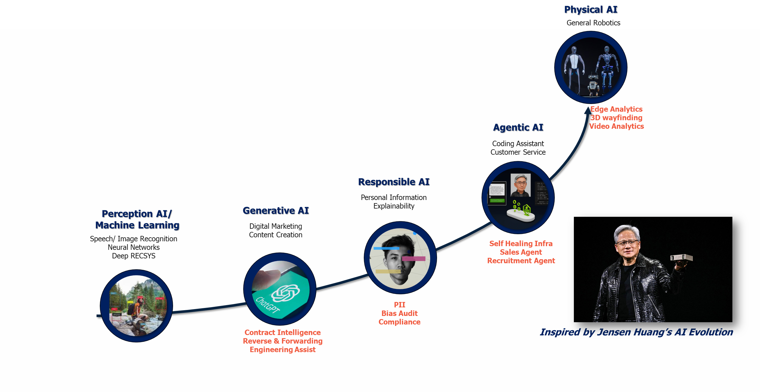

Laying the Foundation: Machine Learning Beginnings
Reducing False Positives in AML for a Global Bank
ML Classification Model trained on historical false positives.
Fuzzy Matching & Compliance Data Integration for enhanced risk scoring
30% Improved fraud detection
Enhanced compliance
ML-Based Alert Noise Reduction for Airline Disruption Notifications
ML model to predict useful alerts using historical data, context-aware filtering based on weather/operational context, and dispatcher feedback integration.
80% reduced alert fatigue, improved dispatcher productivity
Machine Learning is a branch of artificial intelligence that enables computers to learn from data and improve their performance over time without being explicitly programmed.
Instead of following fixed rules, ML systems identify patterns in data and use those patterns to make predictions or decisions—like recognizing faces in photos, recommending products, or detecting fraud.
Predictive Analytics for Risk Profiling For Airport Solution Provider
ML model to predict high-risk passengers using historical travel patterns and behavioral attributes using Clustering.
77% reduction in false positives
+2% improvement in hit accuracy
Financial Document Summarization & Sentiment Analysis
Used NLP to extract key highlights and sentiments from 10-K/10-Q filings. Trained multi-year financial sentiment models to detect speculative language.
11% Stock Price prediction Accuracy 70%+ reduction in manual review time.
Notes:
Southwest Airlines, where they aimed to build a solution for estimating off-block time to optimize flight operations. Traditionally done manually, this process resulted in increased costs. The team, along with Southwest's Data Science team, developed a sophisticated decision-making engine powered by AWS Sagemaker. The algorithm processes real-time data from two key sources, the Passenger Event System (PES) and Wolf, one hour before flight departure. This model, deployed in five airports, has shown a 4-6% reduction in fuel consumption, estimated annual savings of 2-4 million dollars, and a 15% improvement in gate utilization

Slide 24

Embracing Creativity: The Rise of Generative AI
GenAI-Based Risk Score Assessment Using Z-Score
Deployed GenAI to automate financial creditworthiness evaluation based on Edward Altman’s Z-Score model.
Provided dynamic commentary on Z-score drivers
20% Reduction in Manual Data Interpretation
Reverse & Forward Engineering for Mainframe
Copilot-assisted forward engineering boosted developer productivity by 40%
Reverse engineering TPF code into natural language streamlined SME design inputs.
40% faster migration
30% reduction in development effort
Generative AI (GenAI) refers to advanced AI models capable of creating new content—such as text, images, code, or audio—by leveraging Large Language Models[LLM]. Unlike traditional AI that classifies or predicts, GenAI generates outputs that mimic human creativity and reasoning, but is susceptible to hallucinations
GenAI-Powered PLSQL Modernization for a Retail Major
GenAI-based code transformation to modernize legacy PLSQL.
Automated documentation generation for improved maintainability.
30% faster modernization of PLSQL code
AI-Powered Insights from Airline Contracts
LLM-driven system to extract fare discounts from multi-format airline contracts, with region-wise rate identification and downstream integration
25% boost in business team productivity

Slide 25

Building Trust: The Responsible AI
Virtual Assistant Compliance & Cost Control for Pet Supplies Major
Integrated Coforge TrustAI with internal virtual assistant to enforce PII guardrails
15% reduction in LLM usage based Enabled user-level quota management
Bias Auditing & Model Transparency for Western EU Government
Enabled deep bias detection (inter/intra, temporal) in foreign affairs models
Delivered comprehensive bias audit reports to Parliament, aligned with regulatory standards
Increased model accountability
Enabled targeted interventions
Responsible AI refers to the design, development, and deployment of AI systems that are explainable, ethical, transparent, fair, and accountable. It ensures AI technologies align with legal standards, societal values, and organizational integrity.
AI for PII Redaction in Text & Audio
Legal-grade redaction, preserving context and privacy
Reduced breach costs, improved compliance
Responsible AI for Detection & Redaction – Healthcare & Legal
Combines GenAI and policy filters for privacy compliance
Preserves conversational flow, ensures compliance

Slide 26
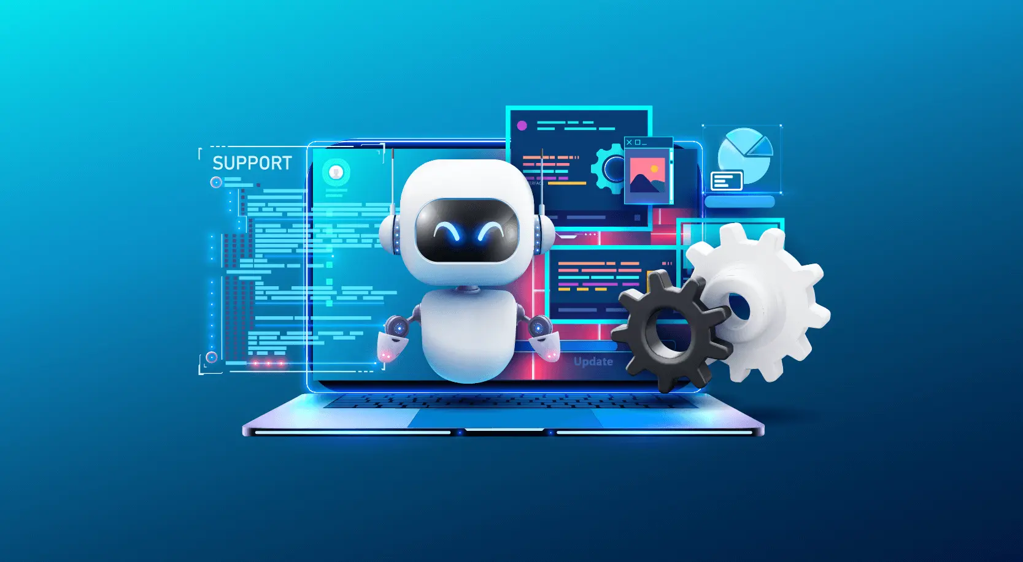
Taking Action: The Leap to Agentic AI
AI-Augmented Sales Agent for Product Intelligence
GenAI agent built using Vertex AI (Vision, Embedding, LLM) to process multimodal product data (pdf, mp4, doc, etc.)
Guardrails ensure scope control, recency, and safe responses
30% Faster query resolution
25% Increase in conversions through
Self-Healing Infrastructure Agent – Insurance Sector
Automated self-healing actions like service restarts, traffic rerouting, and configuration adjustments
70% reduced downtime
Increased operational efficiency
Agentic AI refers to autonomous AI systems that can perceive, reason, decide, and act independently to achieve defined goals—often across dynamic and multi-step workflows. Unlike traditional automation, which is rule based, Agentic AI exhibits goal-directed behavior and can adapt to changing contexts.
Agentic AI for Recruitment – Investment Firm
110 AI agents deployed, including for job profiling, matching
25% faster hiring
35% increase in match accuracy
Advisor Copilot – Wealth Management
Multilingual GenAI assistant for earnings calls, IPO, and trend feedback
60% reduced prep time
Enhanced UX

Slide 27

Embodied Intelligence: The Emergence of Physical (Multimodal) AI
3D Wayfinding for Airports & Malls
3D visualization + indoor positioning (GPS, Wi-Fi, Beacons) to help users navigate complex environments with real-time, AR-supported direction.
Reduced navigation confusion
Increased footfall conversion
Aircraft Turnaround Monitoring Using Computer Vision
Open-source CV tool monitored key turnaround events in real time, connected to camera feeds, and worked on cloud/on-premise infrastructure..
Optimized runway and stand utilization
Increased operational efficiency
Physical AI refers to the integration of artificial intelligence with robotic systems and physical environments, enabling machines to perceive, interact, and operate in the real world. It combines computer vision, sensor fusion, motion planning, and autonomous control(multimodal) to bridge the digital-physical divide.
Edge Analytics for Predictive Maintenance in Agri-Tech Equipment
Real-time machine telemetry integrated into Azure Cloud; expert alert engine and usage-life prediction models enabled proactive servicing.
25% reduction in machine failures
75% uplift in aftermarket parts revenue
AI-Powered Mobile App for Airway Bill Extraction from Cargo Labels
On-device Computer Vision to extract Airway Bill (AWB) info in real time.
Used Google ML Kit for native Android integration.
~95% accuracy for page level details

Slide 28
Coforge Builds Beyond Business Solutions – Accelerating Transformation with AI-Powered SDLC, IT Delivery & Data Intelligence
Software Development Lifecycle(SDLC)
IT Service Management (ITSM) and IT Operations
DevOps
CI & CD
Data Management & Governance
Intelligent Data Analytics & Decision Making
Compliance & Security in Software & IT Infrastructure
AI Coding Assistants
Automated Ticketing & Resolution
AI-Powered Deployment Automation
Automated Data Quality Checks
Automated Data Insights Generation
AI-Powered Risk Assessment
Automating code completion, bug fixes, and best practice recommendations
AI categorizes, prioritizes, and resolves tickets in real time
Predicts failures and optimizes release processes
AI ensures data integrity and accuracy
AI identifies patterns, trends, and correlations in data
AI identifies compliance gaps and security vulnerabilities
Automated Code Review & Security
Proactive IT Monitoring
Intelligent Resource Allocation
AI-Driven Data Cleansing & Deduplication
AI-Powered Predictive Analytics
Threat Intelligence & Anomaly Detection
AI-driven scanning for vulnerabilities and compliance gaps
AI detects anomalies and prevents system failures before they occur
AI dynamically manages cloud workloads and computing resources
Eliminates inconsistencies for better analytics
Forecasting trends for proactive decision-making
AI-powered cybersecurity solutions prevent data breaches
AI-Powered Testing
AI-Driven Root Cause Analysis
AI-Driven Log Analysis
AI-Powered Metadata Management
Conversational AI for BI & Reporting
Automated Policy Enforcement
Automated test case generation, defect prediction, and regression testing
Identifies patterns in incidents to suggest permanent fixes
Identifies operational inefficiencies and security threats
Enhances discoverability and compliance in enterprise data lakes
AI-powered chatbots enable real-time access to data insights
AI ensures IT infrastructure adheres to security policies
Predictive Data Governance
Automates regulatory compliance and data access control
Reduced development time by ~30%
Improved code quality
Decreased security risks
Enhanced IT support efficiency by 40%
Reduced downtime
Reduced deployment failures by ~50%
Optimized IT resource utilization, reducing cloud costs
Improved data accuracy for insights
Reduced manual data preparation efforts by 60%
Enhanced data-driven decision-making
Increased business intelligence reporting efficiency by 45%
Decreased security breaches by 70%
Ensured continuous compliance with global regulations

